Slide 1
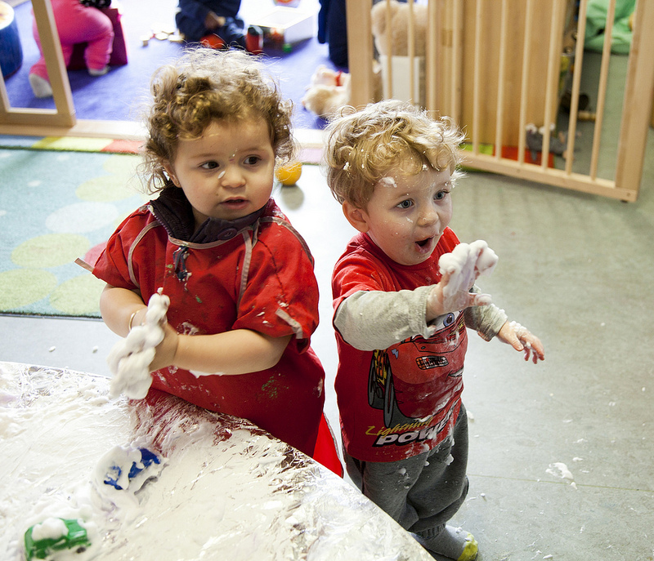

Diversity and identity - the early childhood workforce
Dr Eunice Lumsden
Head of Early Years
The University of Northampton
eunice.lumsden@northampton.ac.uk

Slide 2

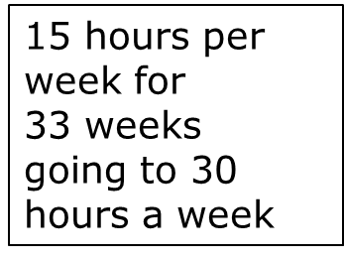
ECEC in England
Mixed Economy
Compulsory schooling from 5
Nursery education free for all 3-4 year olds
Free nursery education disadvantaged 2 year olds
Early Years Foundation Stage
Underpinned by Child Development

Slide 3
Why Professionalisation ?
Qualifications
Before 2001 there was no consistency in qualifications – most ECEC workers unqualified
National Standards
level 3 person-in-charge + 50% level 2
Research
high quality, graduate-led ECEC linked to good development (EPPE project) especially for disadvantaged children
Inspection
Ofsted
  ‘outstanding’ settings linked to graduate leadership

Slide 4
Evidence
Health (Marmot 2010)
Poverty and life chances (Field 2010, 2016)
Early Intervention (Allen 2011)
Early Years Foundation Stage curriculum framework (Tickell, 2011)
Child protection (Munro 2011)
Qualifications and Early Years Workforce (Nutbrown 2012)
Longitudinal Study of Early Years Professionals Status (DfE, 2013)
EPPE Research (Sylva et al., 1997-2015)

Slide 5


Graduate leadership is essential for the highest quality ECEC that promotes the best outcomes for children

Slide 6
Qualifications Framework for Early Years 2016
Level | Qualification | Role
6 | Early Years Teacher Status + Bachelors Degree =180 ECTs | Teaching and leading practice across Early Years Foundation Stage
5 | Foundation Degree =120 ECTs
4 | QCF Diploma or HEQF year 1 =60 ECTs | No additional status
3 | Early Years Educator (QCF Diploma = 37-40 UK credits) | Qualified Early Years Practitioner
European Credit Transfer (ECT)

Slide 7
Early Years Teacher 0-5
Flexible Borders
Lumsden (2012)

Slide 8
Locus
of
Practice
Setting Dependent
Holistic Knowledge
Knowledge
Skills
Attributes
Relationship with Child
Government
Involvement
Professional
Identity
CPD
Relationship
with Teaching
Communities
of
Practice
Professional
Status
Holistic
Leadership
Advocacy
Catalyst
for
Change
Relationship
with
Parents/Carers

Slide 9
Based on the Bioecological
Theory of Human
Development
Bronfenbrenner,
2005
Lumsden, 2012
Chronosystem
Macro
Exo
Micro
Meso
Early
Childhood
Development
Chaotic System

Slide 10
Allen, G. (2011) Early intervention: the next steps: an independent report to her majesty’s government. London: Cabinet Office.
Bronfenbrenner, U. (2005) (ed) Making human beings human: bioecological perspectives on human development. London: Sage Publications Limited.
Department for Education (2012) Longitudinal Study of Early Years Professional Status. https://www.gov.uk/government/uploads/system/uploads/attachment_data/file/183418/DfE-RR239c_report.pdf
Lumsden, E. (2010) The new early years professional in England [online]. International Journal for Cross-Disciplinary Subjects in Education (IJCDSE). 1 (3), 253-262. Available from: http://www.infonomics-society.org/IJCDSE/Published%20papers.htm
Lumsden, E. (2012) The early years professional: a new profession or a missed opportunity. PhD thesis, The University of Northampton. Available from:http://nectar.northampton.ac.uk/4494/1/Lumsden20124494.pdf
Field, F. (2010) The foundation years: preventing poor children becoming poor adults. The report of the independent review on poverty and life chances. London: Cabinet Office.
http://povertyreview.independent.gov.uk/media/20254/poverty-report.pdf
Marmot, M. (2010) Strategic review of health inequalities in England post-2010, fair society, healthy lives: the Marmot review [online]. London: Global Health Equity Group. Available from: http://www.ucl.ac.uk/gheg/marmotreview/Documents/finalreport
Munro, M. (2011) Safeguarding children https://www.gov.uk/government/publications/munro-review-of-child-protection-final-report-a-child-centred-system
Nutbrown, C. (2012). Foundations of quality: The independent review of early years qualifications. Final report. Runcorn: Department for Education. https://www.gov.uk/government/uploads/system/uploads/attachment_data/file/175463/Nutbrown-Review.pdf
https://www.education.gov.uk/publications/eOrderingDownload/Foundations%20for%20quality%20-%20Nutbrown%20final%20report.pdf
Sylva, K., Melhuish, E., Siraj-Blatchford, I., Taggart, B and Elliot, K. (2003) The effective provision of pre-school education (EPPE) project: findings from the pre-school period: summary of findings. London: EPPE Office, The Institute of Education. http://www.ioe.ac.uk/research/98685.html
Tickell, C. (2011) Early Years Foundation Stage curriculum/standards framework
http://www.education.gov.uk/consultations/index.cfm?action=conResults&consultationId=1747&external=no&menu=3

