Slide 1
Helena Beeson
Reflection for Scientists:
a collaborative approach through university and beyond

Slide 2
Contents
Background
Current research
The team
Findings from employer interview
Reflective model
Where we are now
Blogging

Slide 3
Background
Informal chat with tutor
Contacts
Common gap in knowledge identified
Resources available
Notes:
Gap = ability to reflect and feed forward
Blogging easy, time, identified students

Slide 4
Research shows that…
Reflective journaling has been used in STEM fields
Employability always a hot topic
Collaborations between universities and employers are very common
      However…
Employers working with LD and Science tutors to reinforce reflection in the workplace… (not much…)

Slide 5

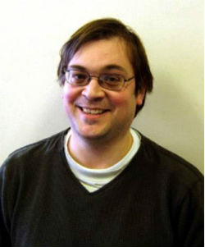

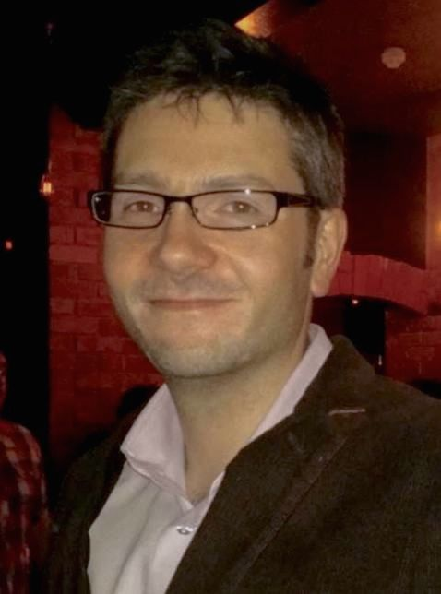

The team

Slide 6
Findings from employer
How is reflection applied in your workplace?
Universally as an iterative process of review and improvement
Peer review process before a piece of work is completed. This aids reflection and consideration…and this can be considerably valuable.
Perspectives: User, Maintenance and Performance
Mike continually reviews situations and builds experience based on reflection, e.g. recruitment tasks, communication difficulties or personality clashes
Notes:
user perspective to make something easier to use and improve communication. Maintenance based (structure or style) and performance based ( can it be done quicker?)

Slide 7
‘Bigger picture’
It is only when a problem is deeply understood in full context that an optimal solution can be found.
Users want a simple quick fix
Full context = more generic solution instead of multiple ‘quick fixes’
Important that components are modular and reusable.
Common reusable solutions – win-win

Slide 8
Graduates applying for jobs
Short university projects = lack of seeing a piece of work through multiple 'completion' phases.
With less experience it is difficult to see 'the bigger picture' simply due to less exposure to all areas of business.
Placements help with this exposure
"Learning by experience is much better than learning by being told what to do!"

Slide 9
Post reflection
In a results driven field it becomes automatic to reflect
In software it is important to allow people to continue to work on projects past the initial completion phase.
Actually painful as an engineer completing a project, reflecting and not being able to go back and address things found in reflection!

Slide 10
Dangers of not reflecting
Repeatedly making the same mistakes
Repeatedly solving the same problem over and over again.
Destroys productivity and efficiency and leads to poor quality work.
"An iterative, reflective approach to completing tasks almost always yields better results"

Slide 11
Reflective model
Based on interview – 2 models chosen
Rolfe et al.
Brookfield’s lenses
Student choice to adapt

Slide 12
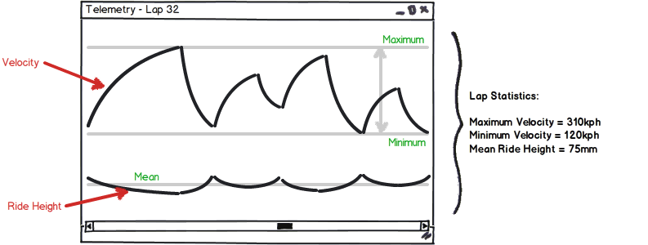
Example project
Summarising lap based track data into easily digestible forms.

Slide 13
Unforeseen circumstances
Communication and scheduling
Student groups / background
Programming languages
Confidentiality of data
Notes:
Getting together to write brief, communicate with employer
Student groups – problems with recruitment, small numbers, language barriers
Students had learned different programming languages to what the team uses

Slide 14
Where we are now
Had to change project
Employer will still talk to students
Team will contribute to blog
Project will go live with the next intake, perhaps a different course

Slide 15
Assignment
“An iterative, reflective approach to completing tasks almost always yields better results”.
How does reflection apply in a technical context?
How does it apply to your specific task?
Watch this for your initial thoughts: http://skillshub.northampton.ac.uk/2013/09/03/brookfields-lenses-video/

Slide 16
Why blogging?
Track thought processes
Close detail thinking
Active, self-directed
Blogging can help me engage more actively in my fields of interests. (Park et al. 2011)
Flexibility - no unified theory of adult learning (Fenwick and Tennant (2004)

Slide 17
Our blogging
Edublogs
Course team check in on student updates throughout project
Engagement not left to the last minute
Prompt questions
Application to real world

Slide 18
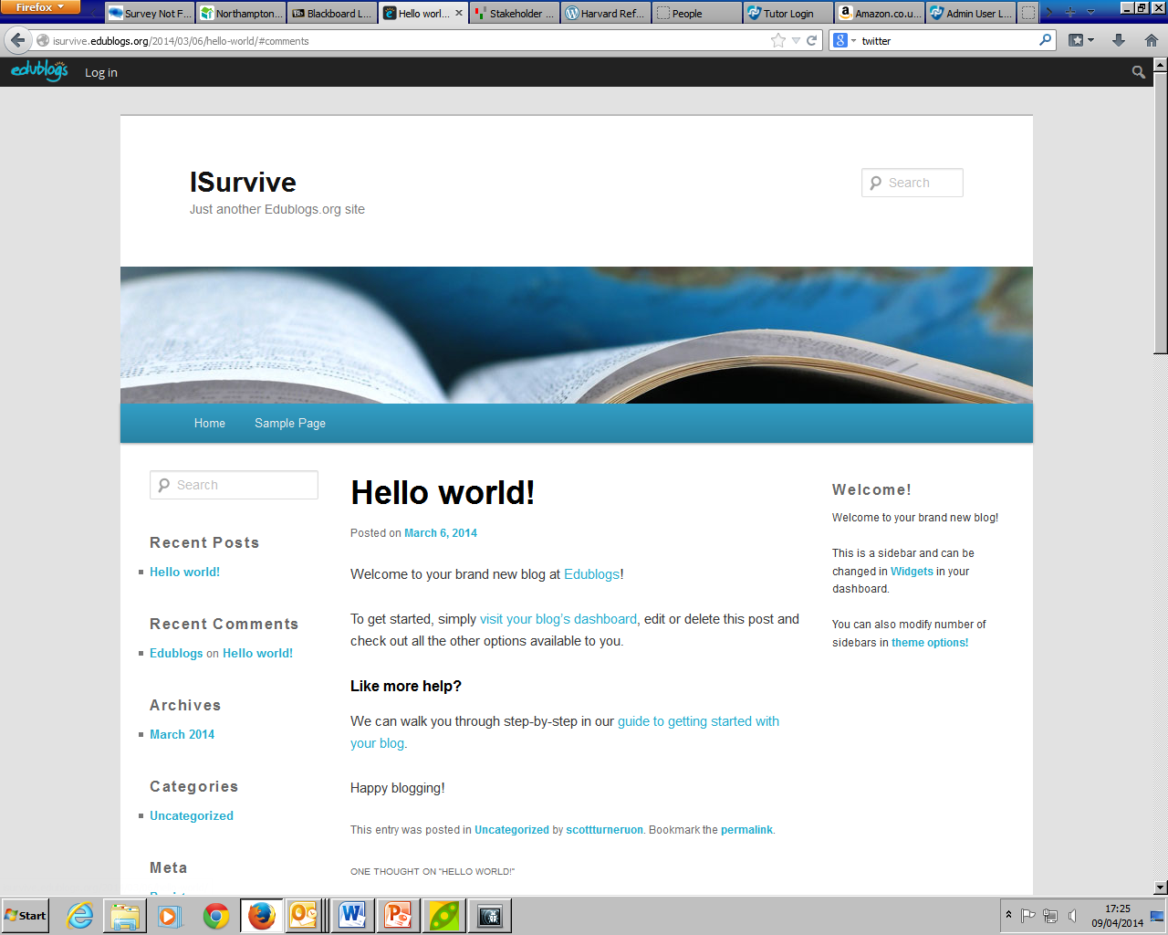

Slide 19
What we have learned so far
Communicate earlier
Establish student groups earlier
You can’t always crowbar a project onto particular students
We are considering the project for a PG dissertation as well

Slide 20
Brookfield, S. (1995) Becoming a critically reflective teacher. San Francisco: Jossey Bass
Fenwick, T., and Tennant, M. (2004). Understanding adult learners. In G. Foley (ed.), Dimensions of adult learning: adult education and training in a global era adult education and training (pp. 55-73). Sydney: Allen & Unwin
Park, Y., Heo, G.M. and Lee, R. (2011) Blogging for informal learning: analyzing bloggers’ perceptions using learning perspective. The Journal of educational technology and society. Pp. 149–160
Rolfe, G., Freshwater, D., and Jasper, M. (2001). Critical reflection for nursing and the helping professions: A user’s guide. London: Palgrave Macmillan

