Slide 1
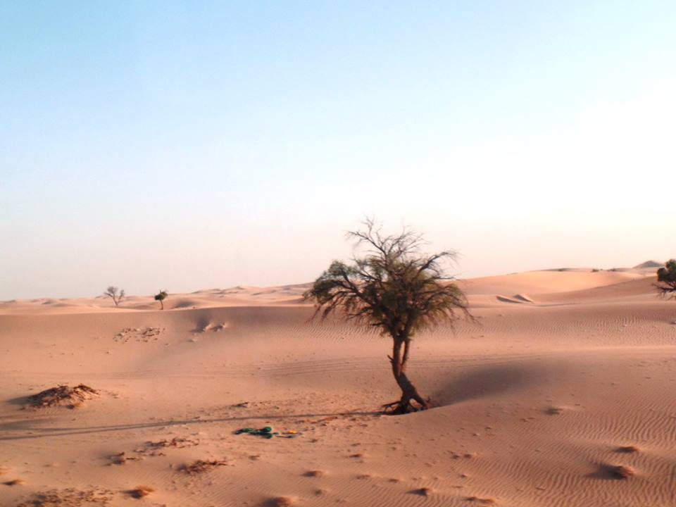

Dawn Hibbert
Head of Research Support
University of Northampton

Slide 2
Journey towards Open Access
2002 – Budapest Open Access Initiative
2003 – Bethesda Statement & Berlin Declaration
2005 – RCUK – position statement on Access to Research Outputs – principals of open access
2008 – Sherpa/Romeo Created
2008 – Open Access Pilot for FP7
2013 – Finch Report & RCUK OA Policy – BIS & RCUK Funding
2013 – Horizon 2020 Launched
2014 – HEFCE’s Open Access Policy Announced
2016 – HEFCE’s Open Access Policy Commenced
2017 – Move to FAIR – Findable, Accessible, Interoperable and Reusable

Slide 3
2013… Finch Report, RCUK OA Policy, BIS, RCUK Funding & Orcids!
“Dirty Manuscript”
“Would jeopardise my career as a serious academic”
“It’s in the library – you can get a copy from there”
“It’s only £30 to buy the journal I publish in, if I make my article free the journal will go under”
“If people want to read my work they should pay for it”
“My work’s not funded by RCUK so doesn’t apply”
“I don’t want everyone to be able to read it, the people in my field are already able to read it”

Slide 4
2014 (After HEFCE’ Open Access Announcement)…
“I don’t have time for this”
“I don’t have to give you anything until 2016”
“It doesn’t apply to my work”
“I can’t find it”
“What’s an accepted manuscript?”
“Can’t you use the published version?”
“Here’s a link to it, it’s on.. (SSRN, research gate or academia)”
“This is the version the publisher gave me”
“What about third party images”

Slide 5
2016/2017
“This is likely to by submitted in the next REF can the University pay for the APC?”
“Can I make my work gold open access retrospectively?”
“We need funding for gold open access for non-funded research”
“You can remove my item if it helps for compliance for the University”
“I’m not going to be submitting it to the REF anyway”
“But it’s in Arxiv/SSRN/Another University, so you don’t need it”

Slide 6

It’s become ALL about

Slide 7
Open Access… But WHEN should it find it’s way into our Repositories?…
As soon as possible?
On Acceptance?
On Publication?
No later than 3 months after acceptance?
No later than 3 months after publication?
Under what licence & conditions?
Should outputs be ineligible if they meet the open access requirements, but not the deposit requirements?
Notes:
For discussion

Slide 8


But It’s NOT just about the REF!
If HEFCE announced that there will be no open access component to the next REF, would our academics deposit anything in our repositories?
Notes:
Do your academics trust you with their work – their outputs – to be curated – are you showing them the benefits of depositing in your CRIS/Repository?

Slide 9


How do we sweeten the deal? Is the stick really better than chocolates?
And / Or
Notes:
Discussion – How can we sweeten open access?

Slide 10
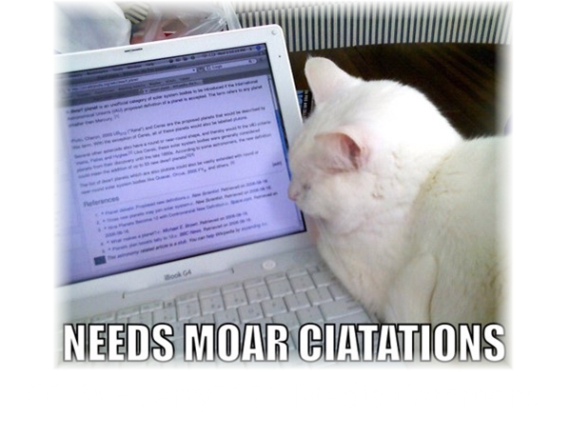
1"The potential for positive effects from open access on citation rates has been widely promoted for some years, but this is the first time we have analysed our home-grown outputs. Not only does open access make our research outputs widely available and visible, we can correlate the open access figures with increased citation rates."(Bath.ac.uk, 2017)
Notes:
Bath.ac.uk. (2017). Open Access increase correlated with jump in Bath citation rates | University of Bath. [online] Available at: http://www.bath.ac.uk/research/news/2017/01/11/oa-citations/ [Accessed 25 May 2017].

Slide 11
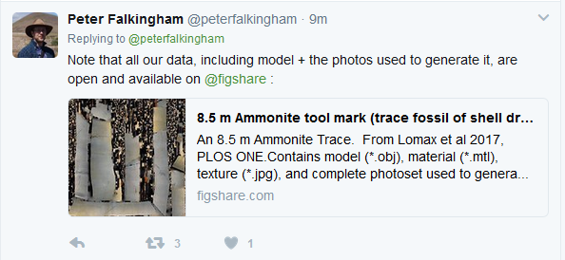
2017… And Beyond… All DATA…FAIR
Notes:
Findable, Accessible, Interoperable, Reuseable

Slide 12

Open Access
Journal Articles
Textbooks
Software
Non-Textual Outputs
Text & Data Mining
Datasets
2017… And Beyond
Acceptance (if reluctant) that articles must be open access!
Extending open access to other outputs
Focus on visibility
Starting to focus on Digital Preservation
“If it’s all open access… How do people find “my” work… And how do “I” find the research “I” need…”

Slide 13
1 Bath.ac.uk. (2017). Open Access increase correlated with jump in Bath citation rates | University of Bath. [online] Available at: http://www.bath.ac.uk/research/news/2017/01/11/oa-citations/ [Accessed 25 May 2017].
Email - dawn.hibbert@Northampton.ac.uk
Twitter - @NECTAResearch

