Slide 1

Open Access…
Increasing engagement with academics to move beyond compliance
Photo by DAVID ILIFF. License: CC-BY-SA 3.0
Dawn Hibbert
Head of Research Support
University of Northampton

Slide 2
Journey towards Open Access
2002 – Budapest Open Access Initiative
2003 – Bethesda Statement & Berlin Declaration
2005 – RCUK – position statement on Access to Research Outputs – principals of open access
2008 – Sherpa/Romeo Created
2013 – Finch Report & RCUK OA Policy – BIS & RCUK Funding
2014 – HEFCE’s Open Access Policy Announced
2016 – HEFCE’s Open Access Policy Commenced
2017 – Move to FAIR – Findable, Accessible, Interoperable and Reusable

Slide 3
2013… Finch Report, RCUK OA Policy, BIS, RCUK Funding & Orcids!
“Dirty Manuscript”
“Would jeopardise my career as a serious academic”
“It’s in the library – you can get a copy from there”
“It’s only £30 to buy the journal I publish in, if I make my article free the journal will go under”
“If people want to read my work they should pay for it”
“My work’s not funded by RCUK so doesn’t apply”
“I don’t want everyone to be able to read it, the people in my field are already able to read it”

Slide 4
2014 (After HEFCE’ Open Access Announcement)…
“I don’t have time for this”
“I don’t have to give you anything until 2016”
“It doesn’t apply to my work”
“I can’t find it”
“What’s an accepted manuscript?”
“Can’t you use the published version?”
“Here’s a link to it, it’s on.. (SSRN, research gate or academia)”
“This is the version the publisher gave me”
“What about third party images”

Slide 5
2016/2017
“This is likely to be submitted in the next REF can the University pay for the APC?”
“Can I make my work gold open access retrospectively?”
“We need funding for gold open access for non-funded research”
“You can remove my item if it helps for compliance for the University”
“I’m not going to be submitting it to the REF anyway”
“But it’s in Arxiv/SSRN/Another University, so you don’t need it”

Slide 6




Slide 7



At least it is in the UK… But… is the STICK better than the chocolates (carrots!)?

Slide 8
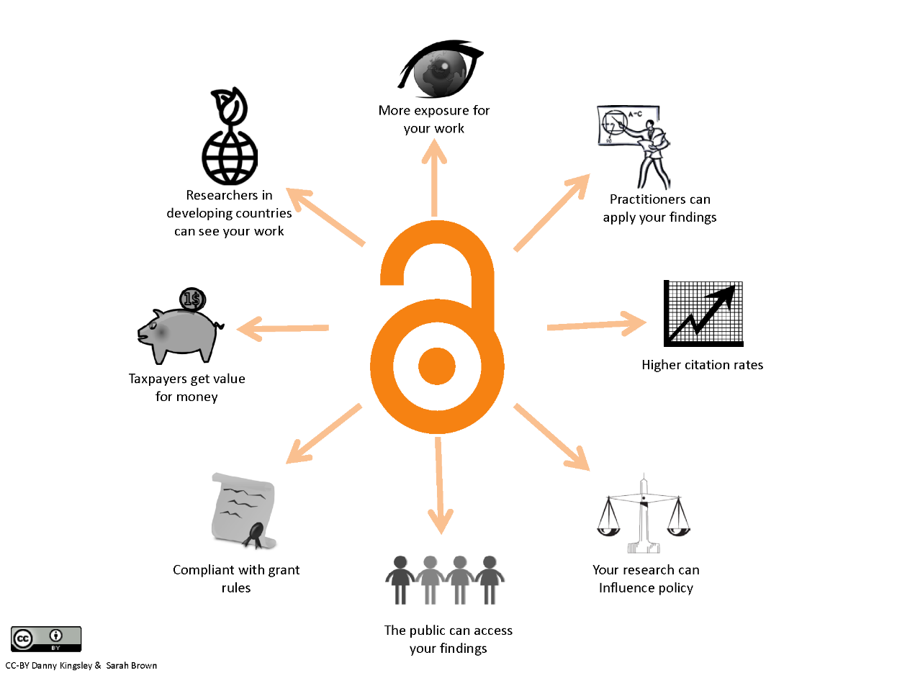



Slide 9
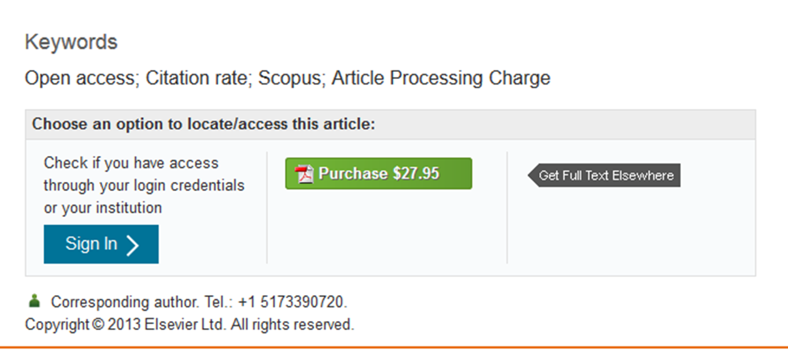
1“Exasperated by rising subscription costs charged by academic publishers, Harvard University has encouraged its faculty members to make their research freely available through open access journals and to resign from publications that keep articles behind paywalls.”
Notes:
Bath.ac.uk. (2017). Open Access increase correlated with jump in Bath citation rates | University of Bath. [online] Available at: http://www.bath.ac.uk/research/news/2017/01/11/oa-citations/ [Accessed 25 May 2017].

Slide 10

2“28 April 2014: Imperial have released their subscription data – £1,340,213. This takes the Russell Group to a total of £15.7 million in subscription fees to Elsevier alone with data related to four universities still outstanding.” (Brook, 2017)
Notes:
Bath.ac.uk. (2017). Open Access increase correlated with jump in Bath citation rates | University of Bath. [online] Available at: http://www.bath.ac.uk/research/news/2017/01/11/oa-citations/ [Accessed 25 May 2017].

Slide 11

3"The potential for positive effects from open access on citation rates has been widely promoted for some years, but this is the first time we have analysed our home-grown outputs. Not only does open access make our research outputs widely available and visible, we can correlate the open access figures with increased citation rates."(Bath.ac.uk, 2017)
Notes:
Bath.ac.uk. (2017). Open Access increase correlated with jump in Bath citation rates | University of Bath. [online] Available at: http://www.bath.ac.uk/research/news/2017/01/11/oa-citations/ [Accessed 25 May 2017].

Slide 12

4“Open Access publications get a 22% higher citation rate” (Kullman, 2014)
Education… Greater Impact… Transparency… Trust!
Notes:
Bath.ac.uk. (2017). Open Access increase correlated with jump in Bath citation rates | University of Bath. [online] Available at: http://www.bath.ac.uk/research/news/2017/01/11/oa-citations/ [Accessed 25 May 2017].

Slide 13
Open Access
Journal Articles
Textbooks
Software
Non-Textual Outputs
Text & Data Mining
Datasets
2017… And Beyond
Acceptance (if reluctant) that articles must be open access!
Extending open access to other outputs
Focus on visibility of research outputs
Shifting focus to Digital Preservation
“If it’s all open access… how do people find “my” work… and how do “I” find the research “I” need…”

Slide 14
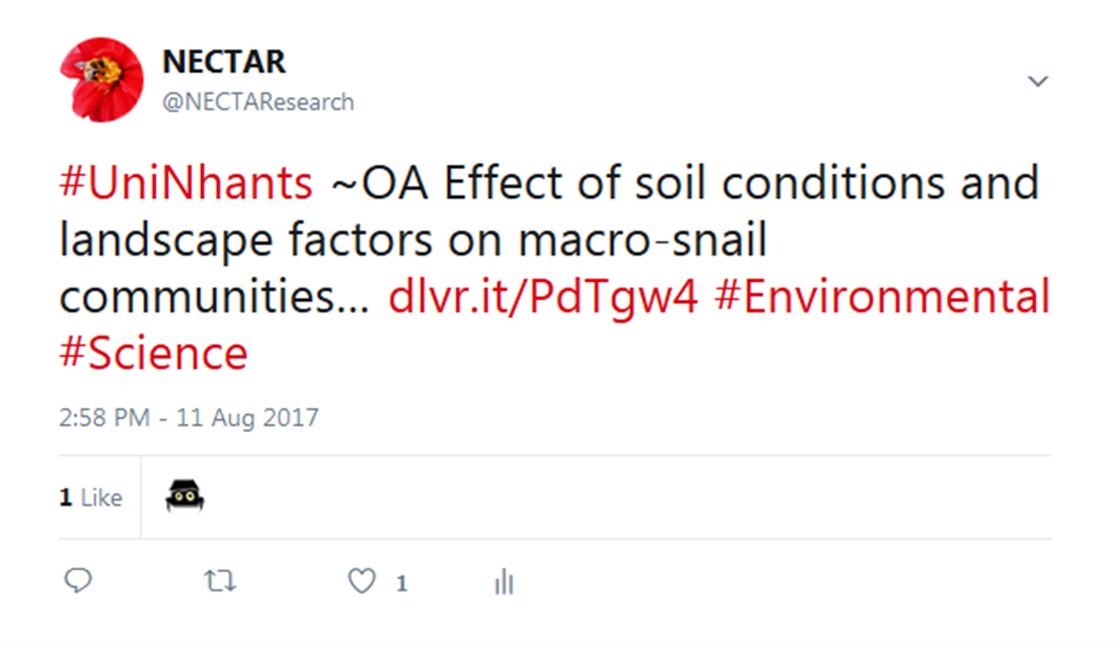
Increasing Engagement with Open Access
Demonstrating the Value – Automatic tweeting of full-text deposited in Repository

Slide 15
Increasing Engagement with Open Access
Decreasing administrative time – clear and precise guidance
Gathering examples of when open access has made a direct different to academics work
Increasing visibility of outputs
Repository – mobile friendly? Indexed?
Provide academics with visual statistics – use of altmetric donut

Slide 16
Increasing Engagement with Open Access
Top 10 Downloads | Full text Downloads
Pickton, M. (2013) Writing your research plan. In: Grant, M. J., Sen, B. and Spring, H. (eds.) Research, Evaluation and Audit: Key Steps in Demonstrating Your Value. London: Facet Publishing. pp. 45-63. | 4861
Lama, A., Bates, M. P., Covington, A. D., Allen, S. C. H. and Antunes, A. P. M. (2013) Methods of isolation and identification of pathogenic and potential pathogenic bacteria from skins and tannery effluents. Journal of the American Leather Chemists Association. 108(2), pp. 48-62. 0002-9726. | 2489
Livingstone, I. and Warren, A. (1996) Aeolian Geomorphology: an Introduction. Harlow: Longman. 058208704X. | 1859
Jackson, P. and Feldman, M. (2011) The EDL: Britainâs 'New Far Right' social movement. Northampton: The University of Northampton. | 1628
Mackley, J. S. (2012) The Anglo Saxons and their gods (still) among us. Lecture presented to: The University of Northampton Staff Research Forum, The University of Northampton, 12 March 2012. (Unpublished) | 1322
Kassem, R. (2014) Detecting asset misappropriation: a framework for external auditors. International Journal of Accounting, Auditing and Performance Evaluation (IJAAPE). 10(1), pp. 1-42. 1740-8008. | 1319

Slide 17
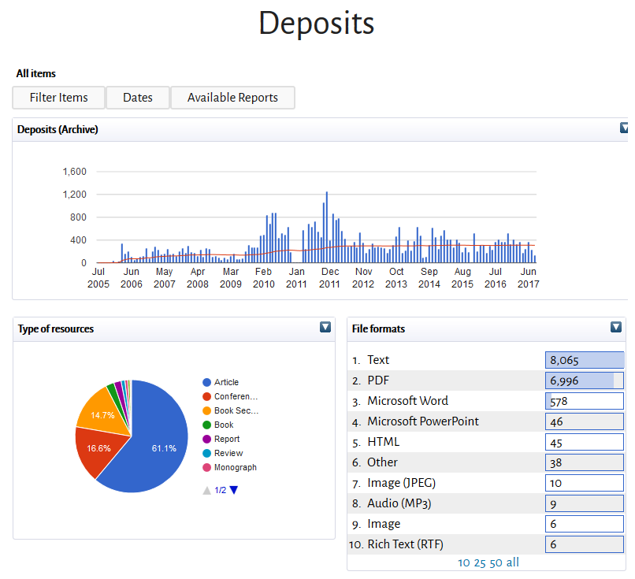
Increasing Engagement with Open Access

Slide 18
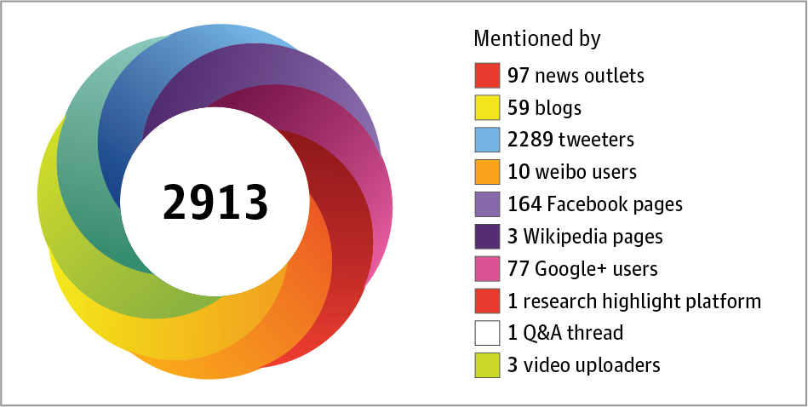
Increasing Engagement with Open Access

Slide 19
Increasing Engagement with Open Access
Impact Story
Kudos
Link from Repository to all other networks
Include DOI of research output in press-releases
Use data from Altmetrics
University profile page
Altmetrics
Resear ch Gate
Blog
Twitter
[prof] Face-book
LinkedIn
About. me
Impact-Story
Repos itory
Academ ia.edu

Slide 20
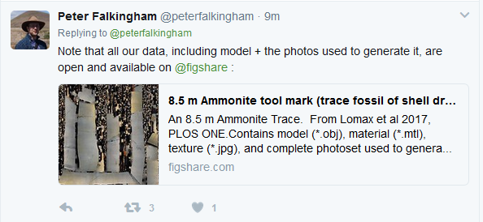
2017… And Beyond… All DATA…FAIR

Slide 21
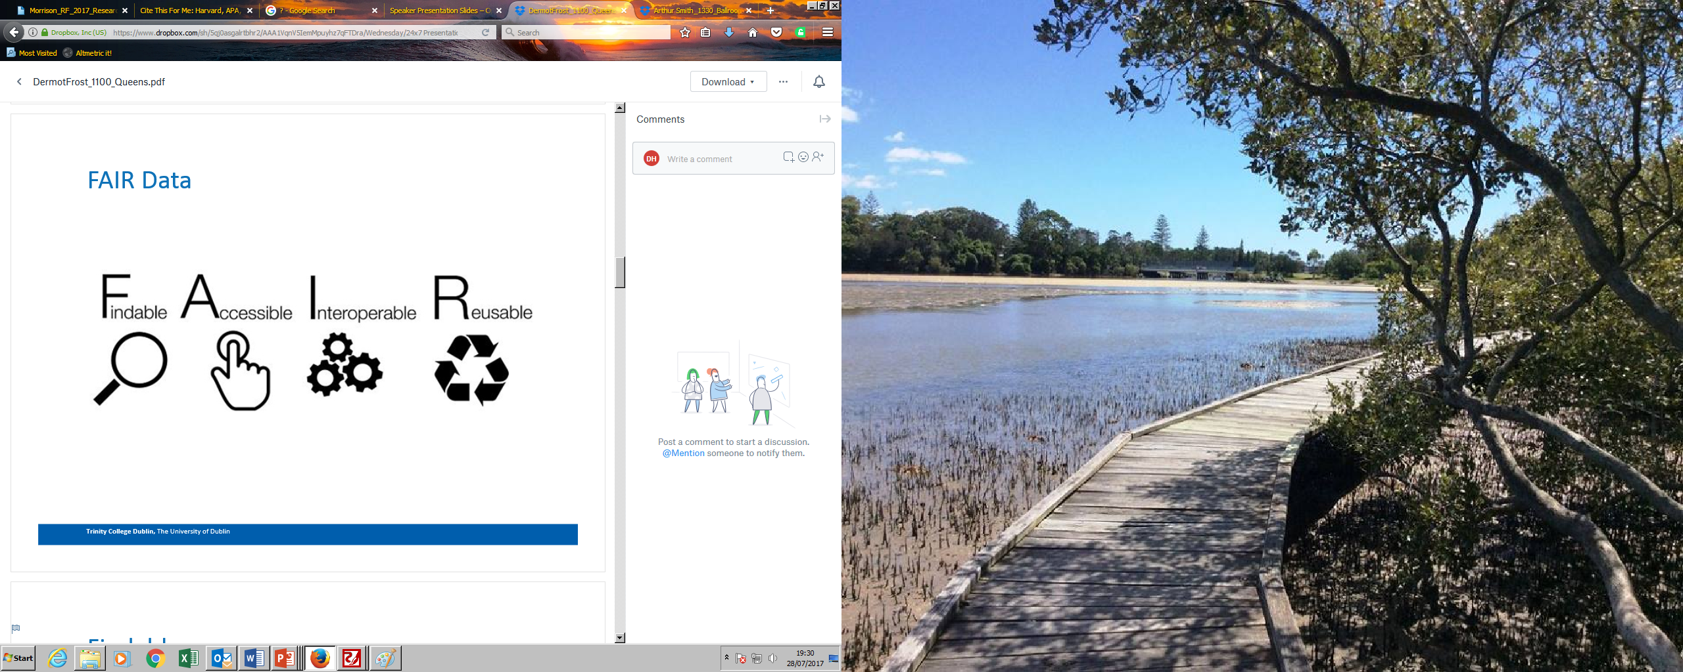

Slide 22
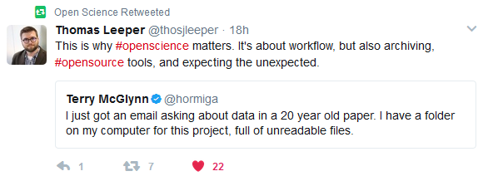
The value of data preservation
“Good Research practice is one of the foundations of high-quality research. Robust, reliable and reproducible studies are fundamental to driving scientific progress” (Wellcome.ac.uk, 2017)

Slide 23
Workflows
Limited Academic Engagement
Mediated Academic Engagement
No Engagement Required
…The path of least resistance & maximum output

Slide 24
Workflows
Limited Academic Engagement
“academics gave us a clear mission: a one button solution to open access.
We haven’t quite achieved that yet, but since May we are running a new workflow that reduces the complexity to one sentence: ‘When you have a paper accepted, deposit the peer-reviewed manuscript – we do the rest, no matter what type of open access.’” (Reimer, 2017)

Slide 25
Workflows
Mediated Academic Engagement
5 Steps… Or more!
Prior to Publishing – check for compliance
Create publication record
Upload Accepted Manuscript
Update record after published
Library staff check metadata (sometimes twice – once on acceptance, once on publication)

Slide 26
Workflows
No Engagement Required (in the future)
Publishers send accepted manuscript and meta data to Repositories, including embargo periods (based on affiliation)
Academics notified when accepted manuscript entered to Repository
Repository automatically updated by publishers when articles published
Repository and Publishers link with Orcids

Slide 27
Workflows
No Engagement Required (in the future)
Do we really want that?

Slide 28
Workflows
Engagement Required
  But minimal administration burden on academics
  Maximum outputs into repositories
  Maximum discoverability
  Knowledge disseminated quickly and preserved for future generations

Slide 29
On/Prior to Acceptance
Yes
No
Email Support Staff
Copyright Addendum
Can Exception be applied
Journal Compliant
No
Yes
Update Accepted Manuscript
Add all metadata, date of publication
Change status from Entry in Progress to For Validation
Advise item ineligble for submission
Item checked by support staff
Embargo Dates entered
Item edited for increased visibility
Item Validated & published/
embargoed
When Published
Update record
Mark for revalidation
Item checked by support staff
Item Validated & published/
embargoed
Item live tweeted by RSS feed
Additional/
Optional Steps
Link to funders
Link to Project
Put into lay terms – use of Kudos
Link to Orcid
Support Staff
Check publisher Policies
Check Accepted Manuscript
Check Metadata
Convert file to PDF/A
Apply file naming conventions
Add exception evidence

Slide 30
Open Access has come a long way, but still has a long way to go… we need to move open access to being seen to be beneficial, and the “norm” rather than compliance and to be extended to data and datasets.

Slide 31

Email - nectar@Northampton.ac.uk
Twitter - @NECTAResearch
Research Support Hub - https://researchsupporthub.northampton.ac.uk/

Slide 32
1 Sample, I. (2017). Harvard University says it can't afford journal publishers' prices. [online] the Guardian. Available at: https://www.theguardian.com/science/2012/apr/24/harvard-university-journal-publishers-prices [Accessed 25 May 2017].
2Brook, M. (2017). The cost of academic publishing. [online] Open Access Working Group. Available at: https://access.okfn.org/2014/04/24/the-cost-of-academic-publishing/ [Accessed 25 May 2017].
3 Bath.ac.uk. (2017). Open Access increase correlated with jump in Bath citation rates | University of Bath. [online] Available at: http://www.bath.ac.uk/research/news/2017/01/11/oa-citations/ [Accessed 25 May 2017].
4 Lars Kullman, (2014) The Effect of Open Access Available at: http://publications.lib.chalmers.se/records/fulltext/198512/local_198512.pdf[Accessed 25 May 2017].
Email - nectar@Northampton.ac.uk
Twitter - @NECTAResearch
Research Support Hub - https://researchsupporthub.northampton.ac.uk/

